Slide 1
Power BI: Data Visualization Airbnb Data Dashboard Preview

Slide 2
Visualizing all goals using crisp-dm method
Business Understanding
Data Understanding
Data Preparation
Modelling
Evaluation
Deployment

Slide 3
DESCRIPTION:- I’vision analytics firm has been provided with datasets related to Airbnb listings and reviewer scores worldwide. The objective is to gain a deeper understanding of Airbnb's operations and draw meaningful insights from the data.
3

Slide 4
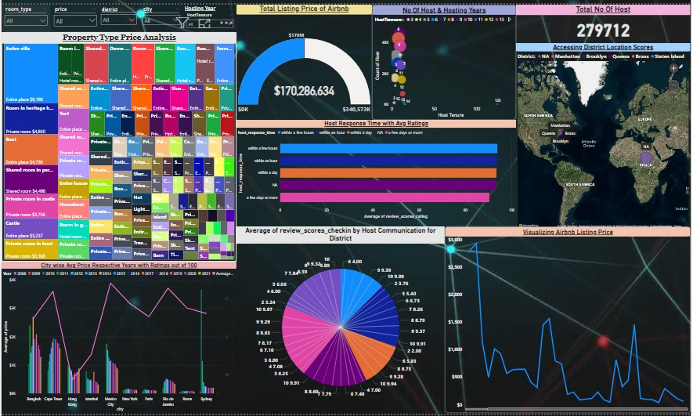
Dashboard Preview

Slide 5
Project goals:-
We have total seven goal to perform and every goal have some information and direction which will help for making chart and visualization.
Assessing District Location Scores
Examining Host Response Time Impact
Visualizing Airbnb Listing Prices
Analyzing Composite Scores
Calculating Listing Age and Host Tenure
Property Type Price Analysis
Crafting a Comprehensive City Insights Report

Slide 6
Cleaning And Filtering the data:-
Firstly we need to upload the data in PowerBI tools where we can apply all those thing and option in which we can use cleaning, arranging and shorting every kind of things.
We have found some missing value and error value which needs to fill all the value using find and replace method.
We have to remove all duplicate value and change the type in which the better things to do.

Slide 7
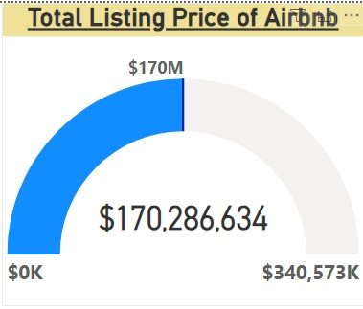
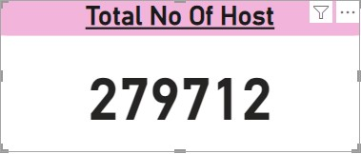
We have two other things for calculate:
Calculate the total no of host using card chart for visualization.
Calculate the total Listing’s price of Airbnb data using Gauge chart for visualization

Slide 8
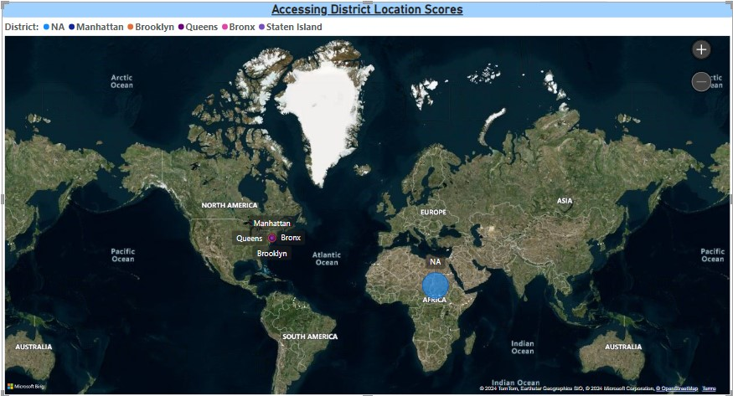

1. Assessing District Location Scores
Here we can find district wise location score using map chart in which latitude and longitude number just move cursor to any bubble which contains all district and show which kind of latitude and longitude have the district. And we have slicer for this map of the district just click on all tab and see all type of district then select any district and showing the location in map and we can know easily what’s the value.

Slide 9
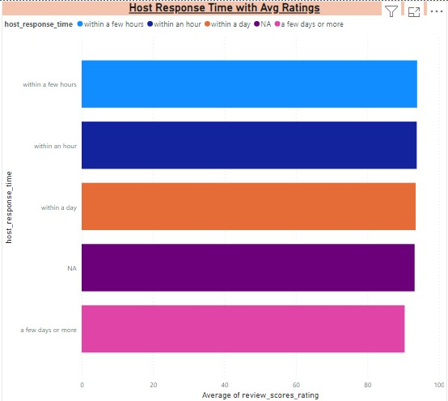
2. Examining Host Response Time Impact
In this chart we can see that which kind of response of the Host and give his average rating out of 100. This chart name is stacked bar chart. Just move the cursor any legend of response and show the ratings. The relationship between host response time and overall ratings through insights of Airbnb listings providing valuable insights.

Slide 10
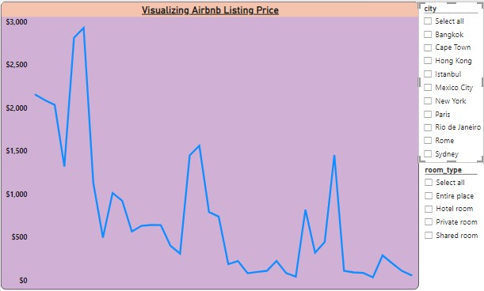
3. Visualizing Airbnb Listing Prices
Airbnb listing prices across cities with our interactive PowerBI analysis. Compare average prices, view distribution in line chart, analyze room type variations, respect with cities, and visualize geographical differences. And having add slicer of cities and room type to show respectively average value in city wise room type.

Slide 11
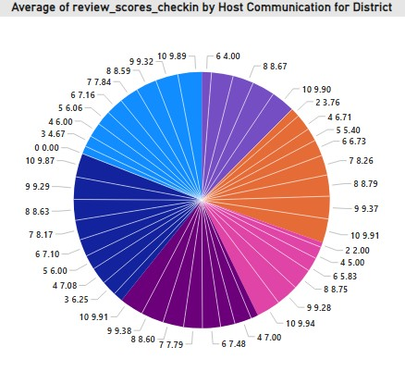
4. Analyzing Composite Scores
Discovering district-level insights by check-in experience and host communication scores into a Donut chart. Visualize the check-in experience scores across districts. Showing insights for optimizing guest satisfaction and host performance.
In this Donut Chart have show the average of listing’s check-in experience score out of 10 and communication with the host for the every district.

Slide 12
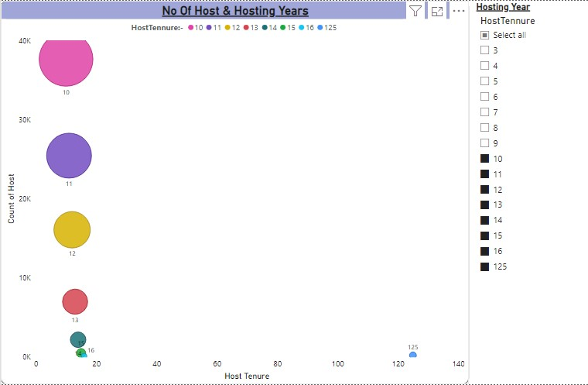
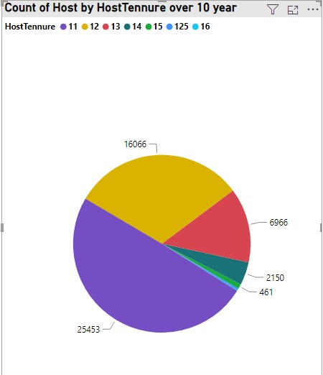
5. Calculating Listing Age and Host Tenure
Visualizing the age of Airbnb listings involves creating a Scatter Chart to display the distribution of listing ages, while identifying hosts with over ten years of hosting expertise can be represented using a pie chart showcasing the proportion of hosts with less than ten years of experience versus those with more using slicer of both chart. This visualization offers insight into the longevity of listings and the expertise of hosts within the Airbnb platform.

Slide 13
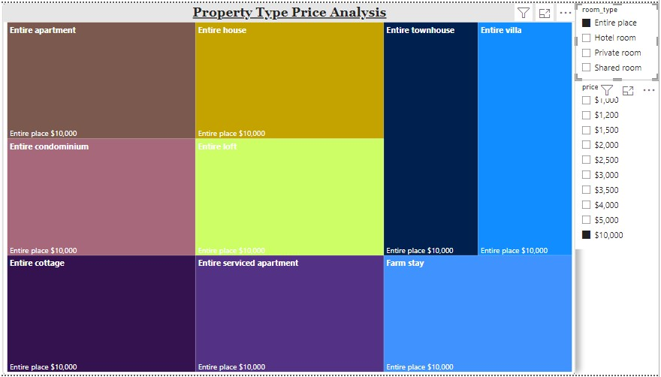
6. Property Type Price Analysis
In this Chart, each rectangle within the treemap represents a different room type and property type on Airbnb. The size of each rectangle corresponds to the average price of that room type and property type, with larger rectangles indicating higher average prices. Special emphasis is placed on identifying the property type that commands the highest prices for entire places, which is highlighted within the treemap for easy comparison.

Slide 14
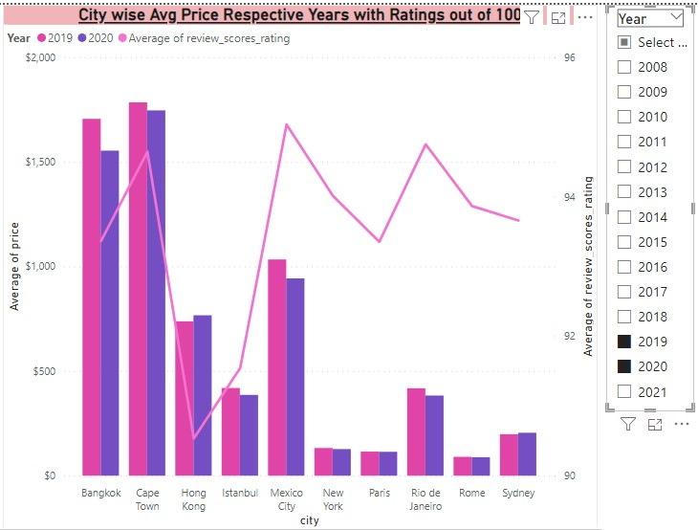
7.Crafting a Comprehensive City Insights Report
Visualize a comprehensive city insights report using clustered column charts to display trends in listing average prices and listing’s overall average ratings out of 100 and visitor statistics across multiple cities. Focus particularly on comparing visitor trends in 2020 with previous years to assess changes to show what’s the difference in prices.

Slide 15
Results & Descriptions
All of the chart have create followed the CRISP-DM method.
After completing the project goals, the outcome analysis of Airbnb listing and across different districts and cities.
This would include insights into location scores, host response times, listing prices, host tenure etc.
Airbnb refers to the ability of hosts to adapt and respond creatively to various situations or requests from guests during their stay. Ensure a positive experience for guests, even when unexpected issues arise.

